Slide 1
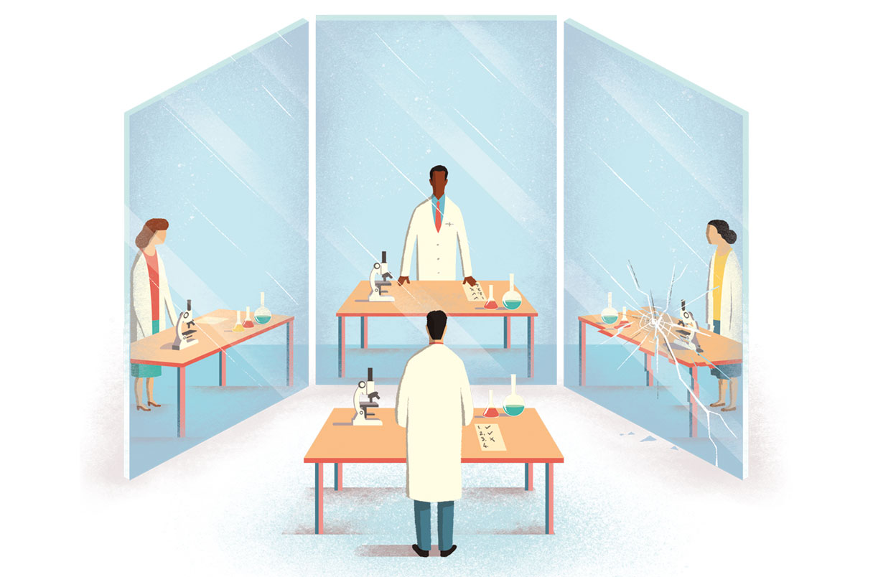
Encouraging rigorous and reproducible research
Carol Wilusz PhD
Professor, Colorado State University
Fulbright Scholar to the Czech Republic 2025
Funded by NIH and the Fulbright Commission

Slide 2

Overview
Why are we here?
What are the causes of the reproducibility crisis?
What are some solutions?
Ways to create a lab environment that encourages rigor and reproducibility

Slide 3
How I got here…….
Running a molecular biology research lab (>20 years)
Testing 60% of the sewage in Colorado for COVID for 3 years
Running a graduate program since 2018
Leading Rigor & Reproducibility Workshops (4 years)
Helping faculty and students deal with conflict (6 years)
Teaching Rigorous Research Methods course (>10yrs)
Being contracted to conduct an experiment for a law firm

Slide 4
What made you decide to come today?

Slide 5
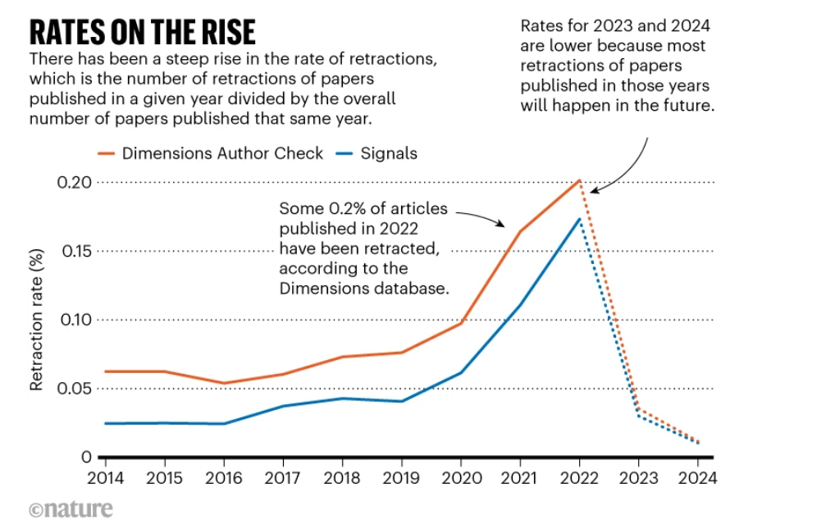
Why?
87 experiments
Van Noorden Nature 2025

Slide 6
Factors Contributing to Irreproducibility
Only +ve results
Selective reporting of the published literature
Pressure to publish
Low statistical power
Poor statistical analysis
Not enough internal replication by original authors
Insufficient study oversight
Lack of training
Failure to make materials openly available
Failure to make original study data openly available
Poor study design
Fraud
Poor quality peer review
Problems in the design of replication studies
Technical expertise required for replication
Variability of standard reagents
Bad luck
HARKing
P-hacking
Funding/time issues

Slide 7
What strategies do you currently use to ensure your research is reproducible?

Slide 8
Some good ways to improve reproducibility
Randomization & Blinding
Publishing negative results / replication studies
Version control
Protocols
Reagents
Cell lines
Plasmids
Datasets
Analyses
Code
Pre-registration/ Planning
Electronic lab notebooks
Templates / SOPs / Checklists
Data Management Plan
Authentication of resources
Antibodies
Primers
Plasmids
Strains
Cell lines
Training in best practices
Statistics
Data management
Software
Instrument calibration
Transparent reporting
data and resources
methods & protocols

Slide 9
Much of this is not new to you!
So why is the problem not going away?

Slide 10

The “Hidden Curriculum”
Knowledge about best practices for rigorous & reproducible research is primarily conveyed through informal means such as mentoring and lab culture
STEM
Coursework
J. Nat. Prod. 2024, 87, 5, 1487-1492

Slide 11
Have you experienced a situation where a trainee made a mistake because they hadn’t picked up on an unwritten rule or convention?

Slide 12

Problems with Implicit Learning
Assumed to occur naturally (but rarely assessed)
Inconsistency:
Students receive different implicit lessons depending on their prior research experiences/opportunities
Gaps in knowledge:
Important skills and knowledge may be omitted
Ethical Concerns:
Students may unknowingly adopt unethical or questionable behaviors
Lack of Awareness:
Students may be unaware of the lessons they are learning, making it difficult to critically evaluate them, or accurately pass them on

Slide 13
tichá pošta
Add 5ml of buffer A and incubate at 37°C for 10 min
Add 5ml of buffer and incubate at 37°C for 10 min
Add 5ml of buffer and incubate for 10 min
Add 5ml of buffer and incubate
It didn’t work!!

Slide 14
How do you know your trainees are learning the right way to do things?

Slide 15
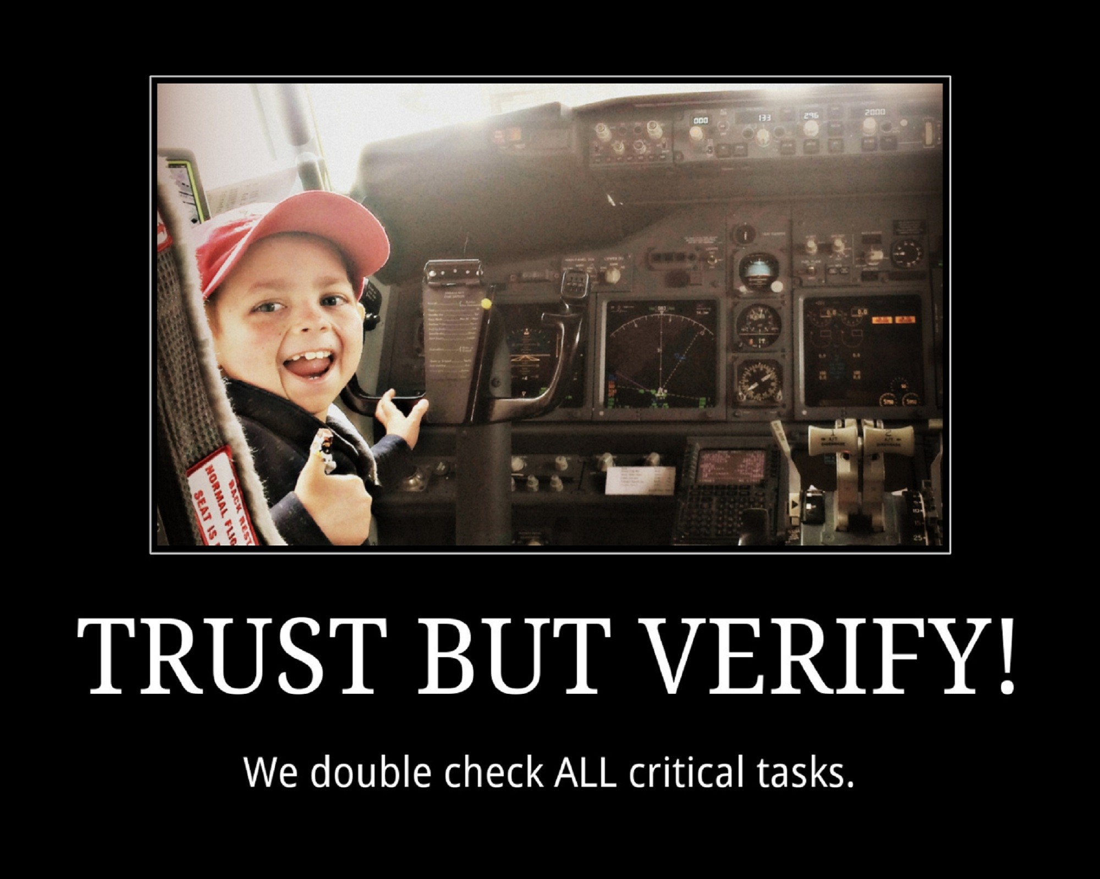
Supplement with EXPLICIT training!
Formal workshops and training
Written documentation and guidelines
SOPs
Code of Conduct
Incorporate discussion of R&R into lab culture
Lab meetings
Journal clubs
One-on-one meetings
Pay attention
Check lab notebooks
Review protocols
Ask questions
Look at the raw data

Slide 16

Make the Right Way Easier than the Wrong Way
People want to do the right thing
BUT if it’s a lot easier to do the wrong thing
AND there’s no immediate consequence
OR they don’t value the right thing
They will do the wrong thing………
Even when they know it’s the wrong thing

Slide 17

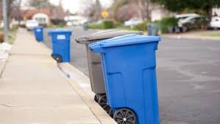
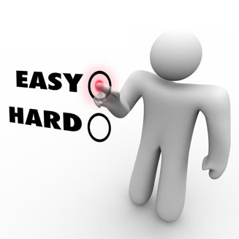
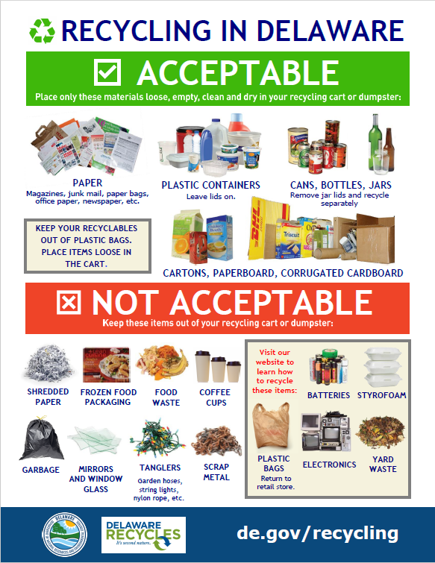
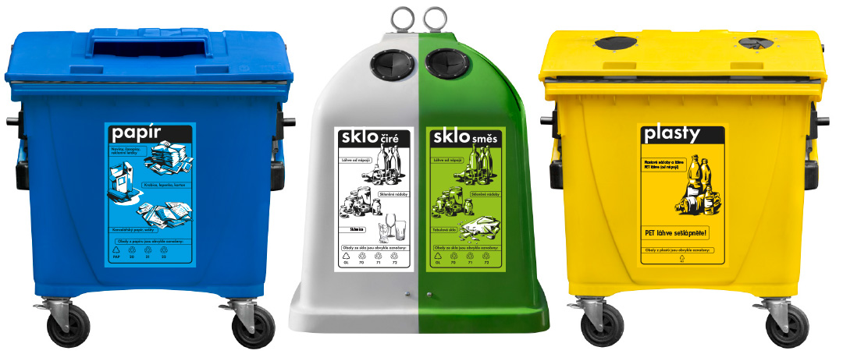
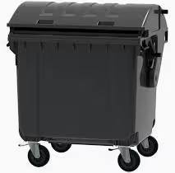
People will only recycle if you make it easy…….
Colorado
Academie Ved

Slide 18
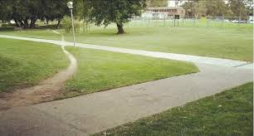
Make the Right Way Easier than the Wrong Way
Provide the necessary tools and training
Onboarding Check Lists
Create accessible SOPs, Templates, Protocols, Manuals
Automate doing the right thing
Version control, templates
Make someone responsible for tedious tasks
Allow/create extra time for it
Notice and reward desired behavior
Make your expectations and values clear
Code of Conduct / Lab Guidebook

Slide 19
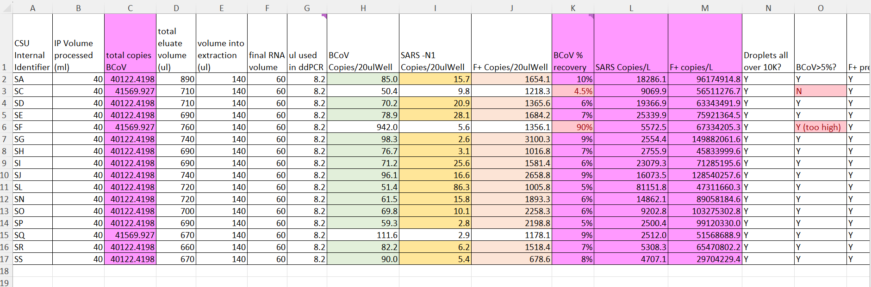
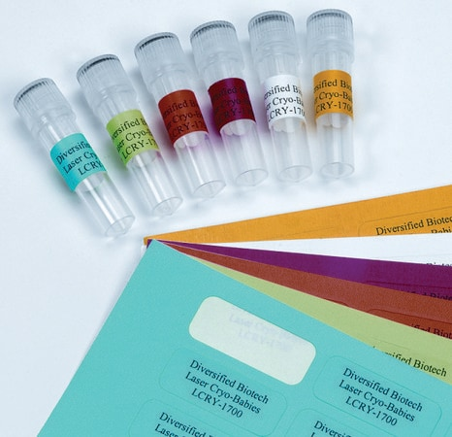
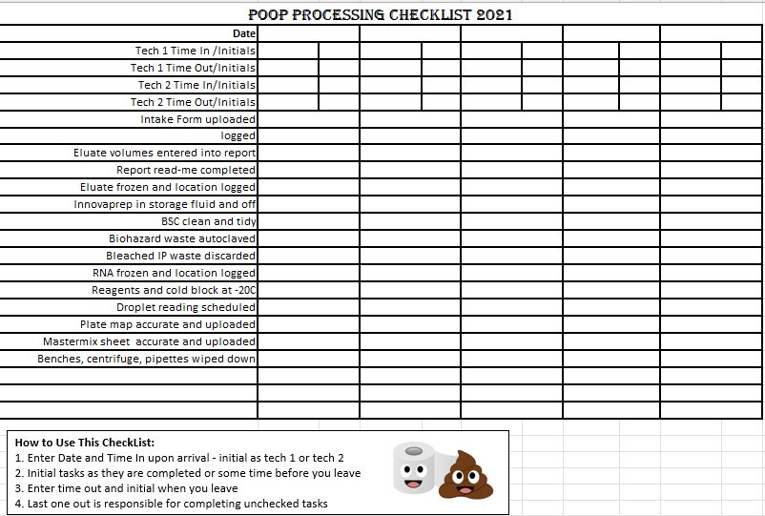
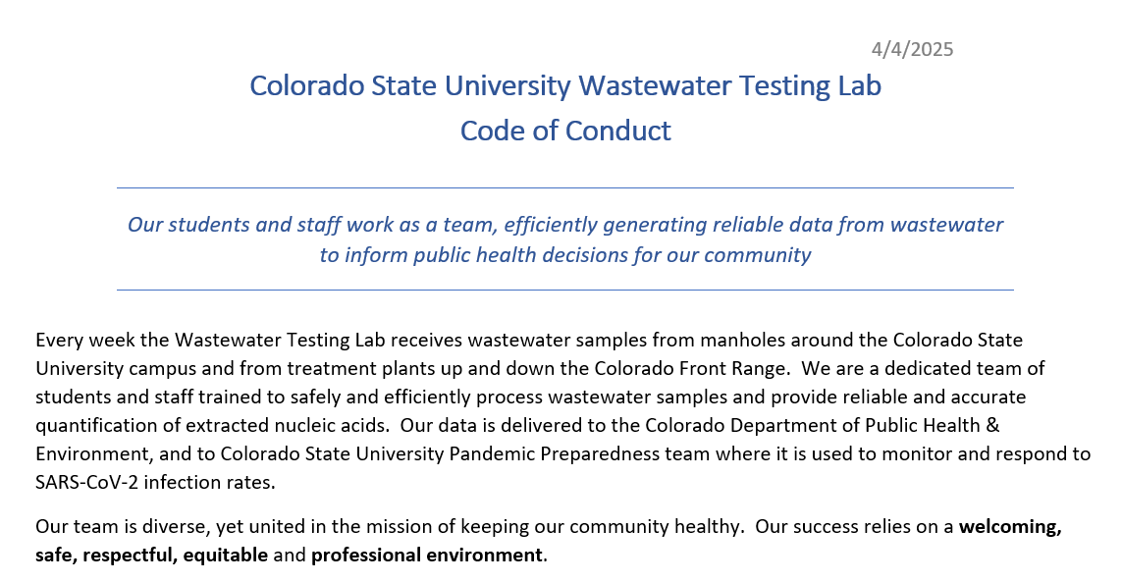
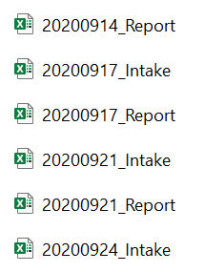
Examples from the Sewer…….
Spreadsheet template for Data Entry and Analysis
Labels for samples printed the night before
Poop processing check list
Lab Code of Conduct
File/Sample Naming Conventions

Slide 20


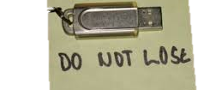
Handling mistakes
Everyone makes them
If you don’t know about them then you cannot fix them
“My post-docs don’t make mistakes”
“You are not welcome here if you make the same mistake twice”
“The Lost Data”

Slide 21
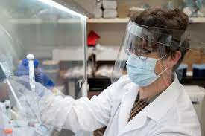
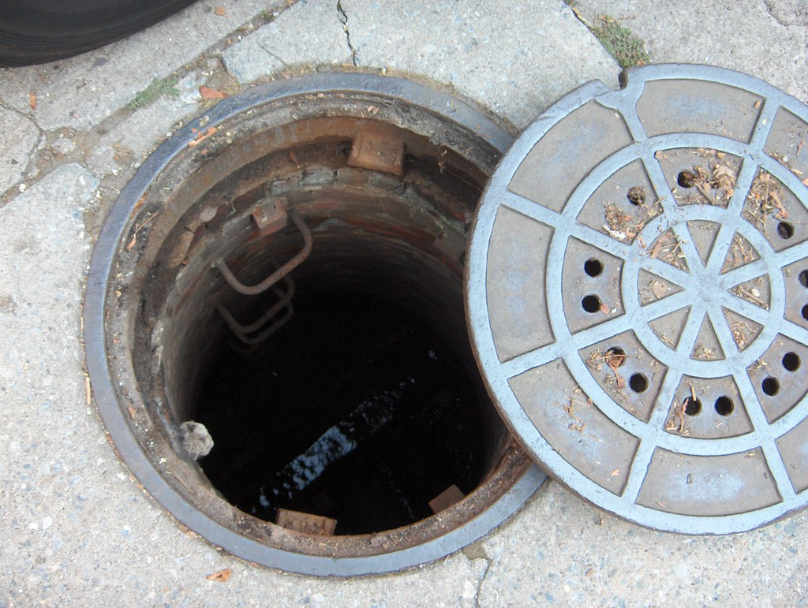
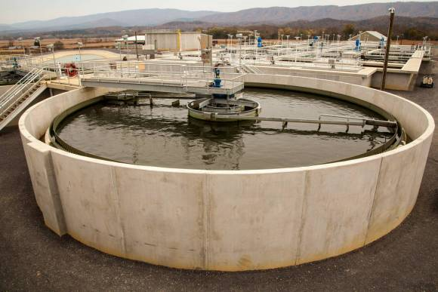


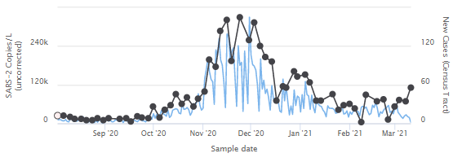






No room for error during COVID
University Dorms
Wastewater Treatment Plants
Grad student and undergrad team working in 8 hr shifts during a pandemic
sample arrival
< 24 hours
publication
Remove solids
Concentrate virus
Quantify
Virus
Report SARS CoV2 genome copies/L
Extract RNA

Slide 22


Don’t point fingers - ask questions
Try not to be too scary! Keep an open mind
Share responsibility – “one fails, we all fail”
Focus on finding solutions and preventing another error
See mistakes as learning opportunities
Consider creating an anonymous reporting system for near misses and risky situations
Have an SOP for mistakes

Slide 23

Know what you don’t know
Learn about p-hacking and HARKing (and ways to avoid them)
Bring in a statistician or a data management expert (and budget for it!)
Encourage your students to get additional training

Slide 24


Lead by Example
Learn about the issues contributing to the Reproducibility Crisis
Take responsibility for training your students in this area
Own your mistakes
Be transparent when publishing
Publish your negative results
Adjust your expectations when reviewing papers and grants
Be more accepting of negative results and replication studies
Hold authors and journals to a high standard with respect to transparency and reporting

Slide 25




Take Home Messages
Create a blame-free environment
Make the right way easier than the wrong way
Lead by example
Make training in R & R explicit
Know what you don’t know – ask an expert

Slide 26
Thank you!
Happy to share resources and engage in further discussions!

Slide 27
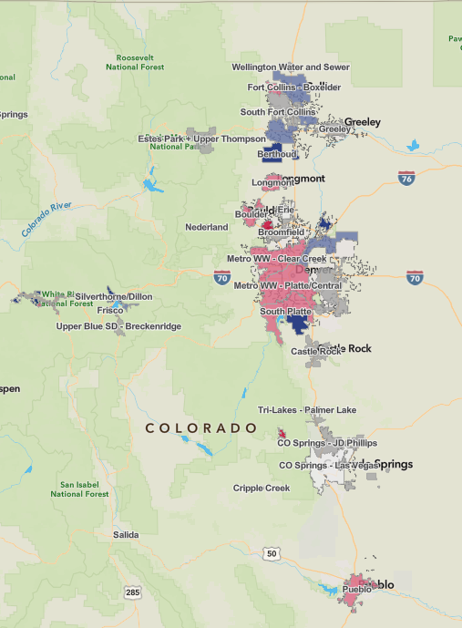



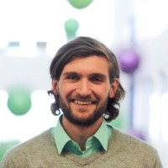


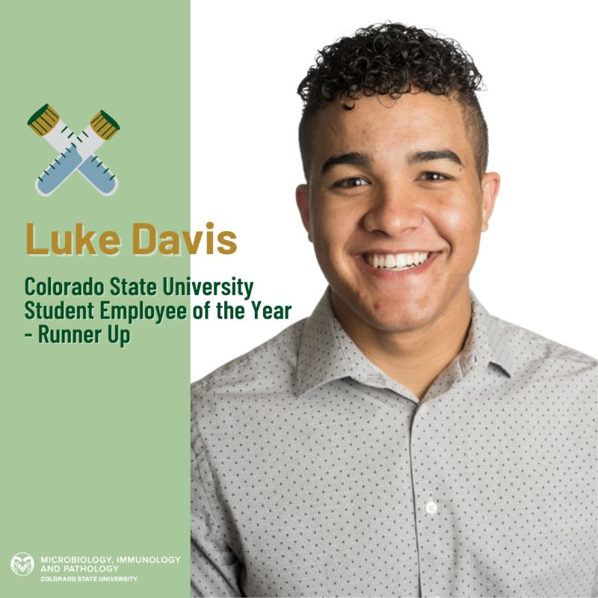
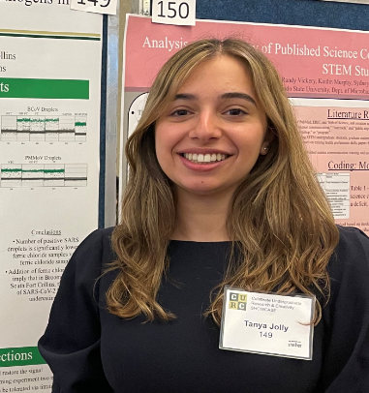

August 2020-July 2023
~60% of Colorado Population tested twice a week
Alexa Doyle
Luke Hampton
James Montavon
9 students trained
Jorge Chavez
CDC Antimicrobial Resistance Fellow
Fertility Lab Tech Washington Univ.
Associate Scientist Biogen
Communicable Disease Training Specialist at CDPHE
Parrish Van Ausdall
Halley Pucker
Luke Davis
Tanya Jolly
Nicole Albert
>200L
WWTP wastewater
Shared protocols and expertise with
8 Universities & Colleges
5 County & State Public Health Authorities
7 Companies
National Public Radio
Denver 9 News
>5000 WWTP samples

